Slide 1
Writing Learning Tasks

Slide 2
‘Active learning’ describes approaches in which students engage with the material they study through activity.
How do we involve learners?
What do we involve them in?
How does what we ask them to do lead to learning?

Slide 3
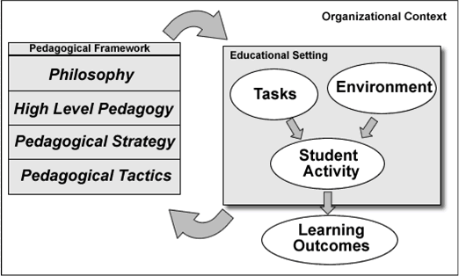

Slide 4
Cognitive Engagement
.... sustained attention to a task requiring mental effort
Authentic, useful learning is produced by extended engagement in optimally complex cognitive activities

Slide 5
Optimally complex activities?
Novice
Capable
Expert
Master
Where are learners NOW?
Helps determine ‘optimal’ complexity
How far can we expect them to move in one week? Six weeks? Helps determine pacing, structure and support

Slide 6
3 Needs in Motivation
Competence
The need to experience oneself as capable of producing desired outcomes and avoiding negative outcomes
Do students feel the task is ‘doable’?
Relatedness
encompasses the need to feel securely connected to the social surround and the need to experience oneself as worthy and capable of respect
Autonomy
the experience of choice in the initiation, maintenance and regulation of activity and
the experience of connectedness between one‘s actions and personal goals and values
when autonomous, students attribute their actions to an internal locus of causality, and experience a sense of freedom and choice over their actions
Do learners feel like they have a choice?
Do students feel they are part of something? That they belong?

Slide 7
Student engagement is the product of motivation and active learning. It is a product rather than a sum because it will not occur if either element is missing.
-Elizabeth F. Barkley
Motivation x Active Learning = Engagement

Slide 8
Qualities of an ‘ideal’ learning task
?

Slide 9
Qualities of an ‘ideal’ learning task
Close link between intended activity and actual activity
tasks *require* the intended activity to be completed
The intended activity is clear to learners:
What? – The particular task deliverables
How? – The process or procedure
Why? – The link between activity and learning within the course (outcomes?)
How well? – How will learners know when they have completed the task successfully? Standards of achievement (quality)

Slide 10
Qualities of an ‘ideal’ learning task
Learner support-What do learners need to be successful in the task?
Clear instructions
task related resources
Learning environments
Communications tools
Particular skills
Other support?
Motivation-
Do students feel the task is ‘doable’?
Do students feel they are part of something? That they belong?
Do learners feel like they have choice or control?

Slide 11
Other considerations
Consider roles: teacher roles, learner roles
Structure in the process: Loose or tight? Milestones?
Time: How much time should learners spend on a particular task?
Outcomes: clear or fuzzy?
The role of a particular task in the module/course/program

Slide 12
Questions?
Examples?

