Slide 1
Small World Networks, Rich Clubs and other Network Measures…
(…for the mathematically challenged).
Bernadine Cocks B.Psyc (Hons), Adv. Dip. Arts
CNeL University of South Australia…Bernie.Cocks@unisa.edu.au

Slide 2
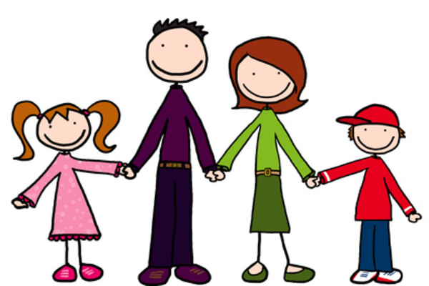
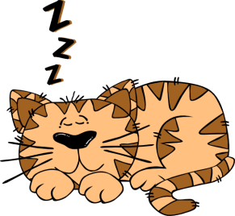
The Small Family
Notes:
Meet the Small family – Simon, Sally, Stan, Sarah, Ceefer, Deefer and Beefer…they look like a fairly average normal family…but are they?

Slide 3
Nodes
Edges
The Small Family Network
Notes:
So to start looking at the Small Family structure or “network” we can start by identifying relationships between each member. We can do this by drawing lines (aka edges) between the members (aka nodes). Straight away, things aren’t necessarily as they seem – for example, Beefer has no relationship with Sally, Stan or Deefer…similarly Simon has no relationship with Deefer. There are various inferences can be drawn from that (perhaps Simon is scared of dogs?)

Slide 4
The Small Family Network
Notes:
To add more depth or meaning to this model of the Small Family network, we can add direction to the relationships (edges)…and this gives us a few more clues about the Small Family…such as it’s pretty much a 1 way interaction between Sally and Ceefer and Deefer (feeding?)

Slide 5
The Small Family Network
Notes:
Then to add even more info, we can add weights – how strong are the relationships within the Small Family network? From this we can start to figure out that Stan and Sarah are perhaps not as close as they could be…and that Simon probably only tolerates Beefer. All in all, however, we have a much clearer understanding of how the Small Family functions as a unit.

Slide 6
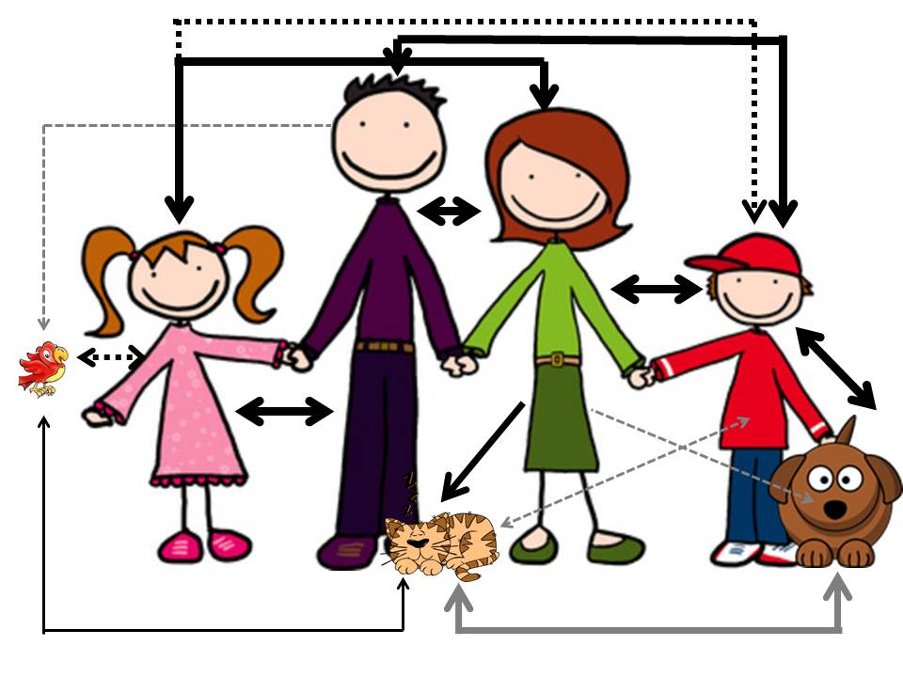
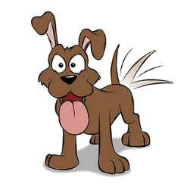
Notes:
But the Small Family doesn’t live in a bubble…each member (or node) can form part of other networks – in this case, still family networks, but different families.

Slide 7
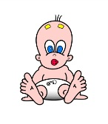
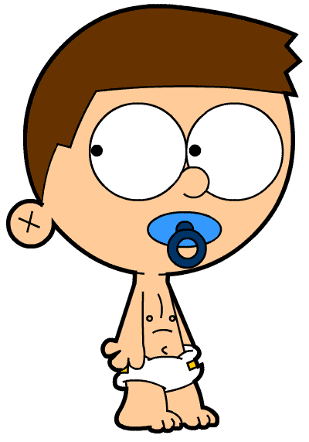
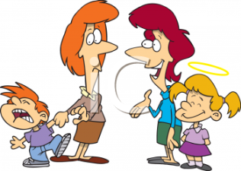
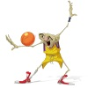
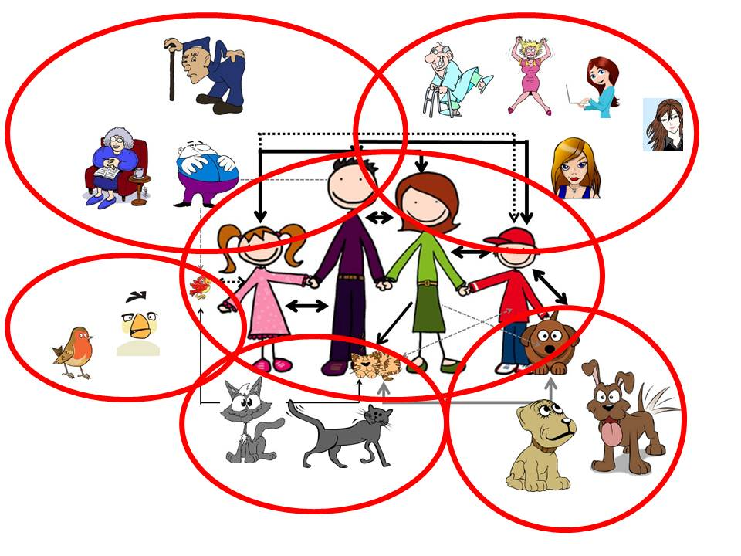
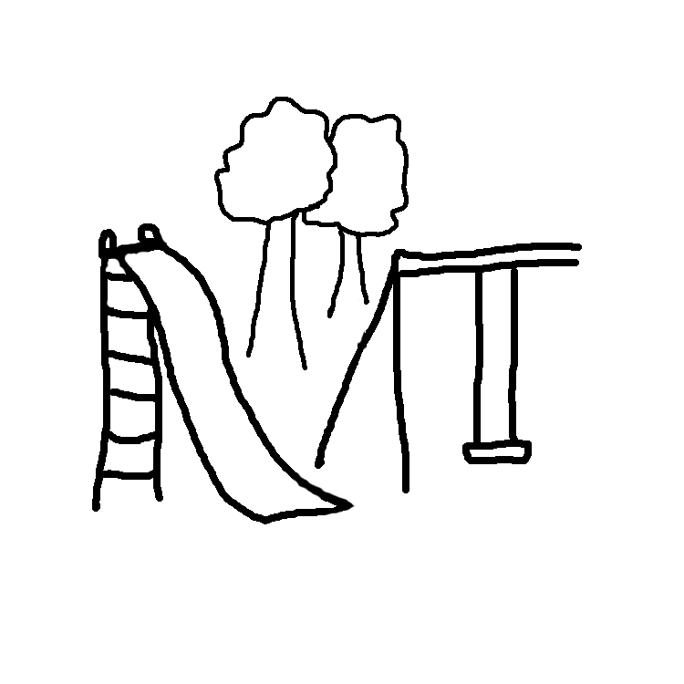
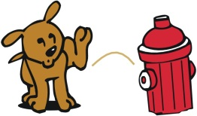
Notes:
Which, in turn, can interact with other networks…which are not, necessarily, adjacent – e.g. Sally’s Dad’s Nurse is the daughter of the crazy cat lady who lives around the corner and feeds Ceefer’s dad…similarly, Sarah’s babysitter is the daughter of one of Simon’s work colleagues.

Slide 8
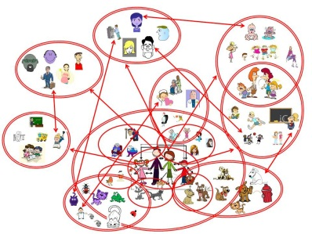
Notes:
Which, in turn, have links with other networks and other nodes which can also be represented by directed, weighted edges…

Slide 9
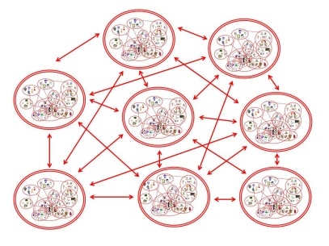
Notes:
Which form even bigger networks…in this case, maybe a city level network?

Slide 10
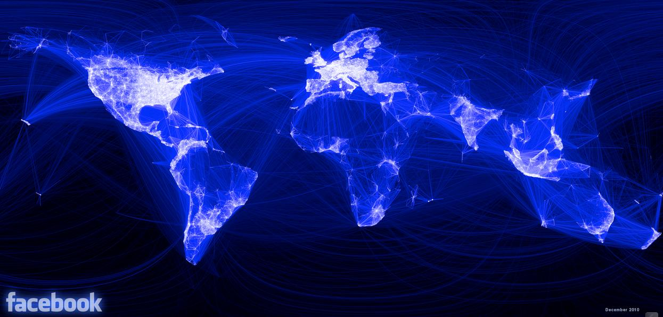
https://termid.wordpress.com/2010/12/14/new-world-wide-web-map-based-on-facebook/
Notes:
And even bigger networks…in this case, a World Wide Web map based on the Facebook Network

Slide 11
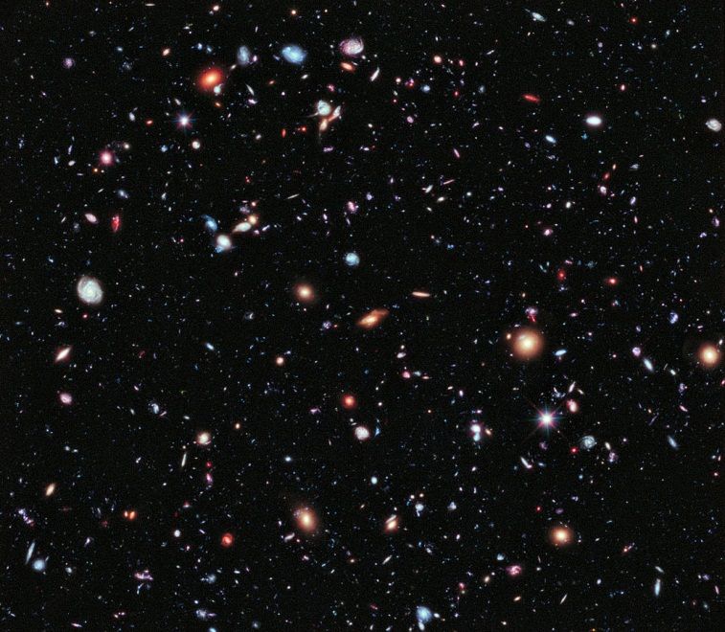
"Constellation Fornax, EXtreme Deep Field" by NASA; ESA; G. Illingworth, D. Magee, and P. Oesch, University of California, Santa Cruz; R. Bouwens, Leiden University; and the HUDF09 Team - http://hubblesite.org/newscenter/archive/releases/2012/37/image/a/warn/, http://www.nasa.gov/images/content/690958main_p1237a1.jpg. Licensed under Public Domain via Wikimedia Commons - http://commons.wikimedia.org/wiki/File:Constellation_Fornax,_EXtreme_Deep_Field.jpg#mediaviewer/File:Constellation_Fornax,_EXtreme_Deep_Field.jpg
Notes:
And even bigger networks…

Slide 12
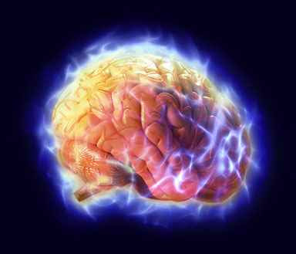
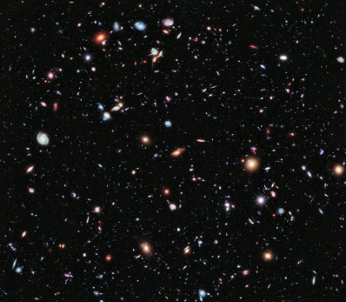
Notes:
So where does the human brain figure in the greater scheme of things so far as network complexity is concerned?

Slide 13
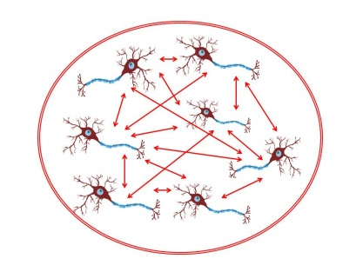
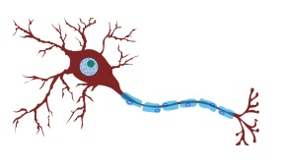
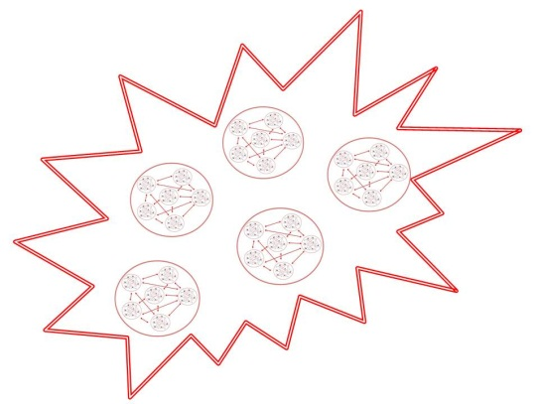
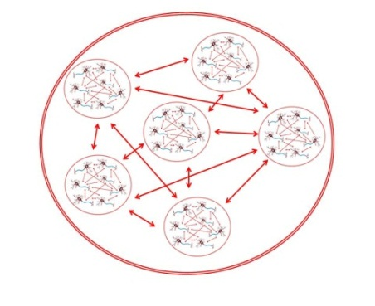
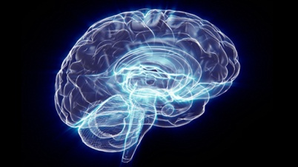
Basic neuronal ensemble – Small World [?]
Neuron
Complex neuronal ensemble – Rich Club [?]
Module [?]
Whole brain activity
Notes:
If we now take the Small Family analogy and apply it to neural function, we see pretty much the same pattern of small world networks combining and recombining at both low and high levels to result in whole brain activity or behaviour

Slide 14
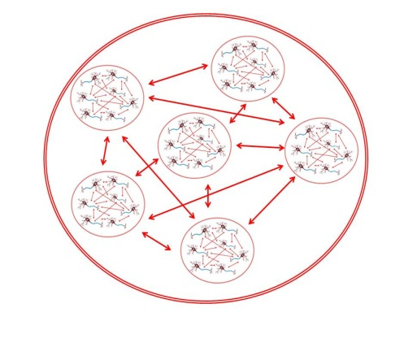
Rich Club
Notes:
To quickly explain a few terms, a Rich Club is a high order network that appears to act as a hub for a variety of smaller small world networks

Slide 15
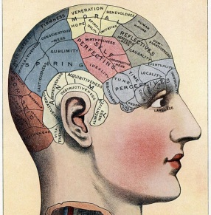
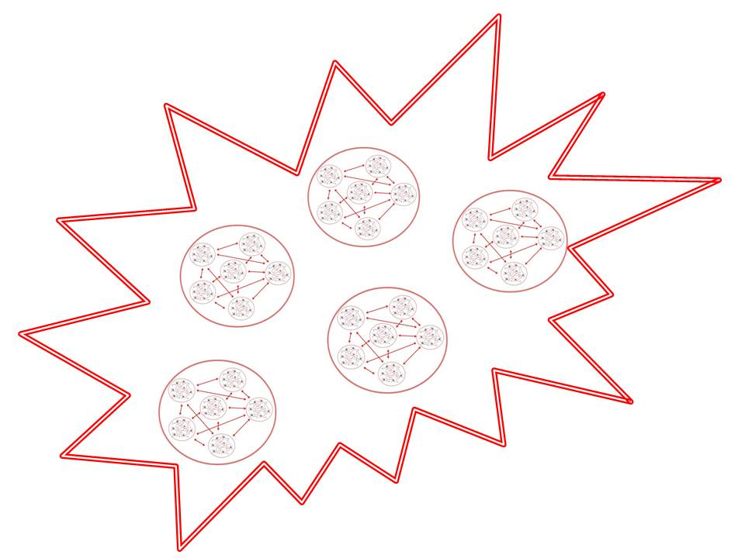
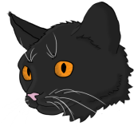
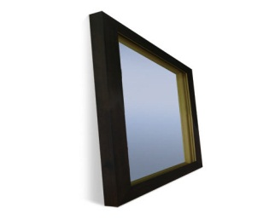
Module
Notes:
A module is more a theoretical concept than a structural/anatomical one (e.g. we’re still looking for Chomsky’s LAD)…but it could also be considered a functional entity – so the “module” that processes music would be a combination of a whole heap of lower level processing units which combine to carry out a function.

Slide 16
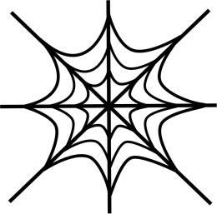
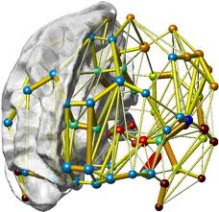
Functional Brain Network [FBN]
Notes:
In some respects, this is exactly what a functional brain network is – except that FBNs can be measured and modules cannot.

Slide 17
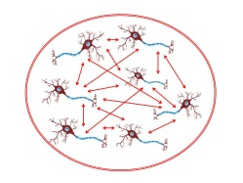
Language (Digestion)
Motor
Vision
Sound
Mouth
Lungs
Diaphragm
Other movements
Tongue
Uvula
Lips
Jaw
Genioglossus
Styloglossus
Hyoglossus
Palatoglossus
vertical
inferior longitudinal
superior longitudinal
transverse
Notes:
As an example of how these different FBNs (or Small World Networks) function at different levels, and how they can be functionally involved in more than 1 process is illustrated.

Slide 18
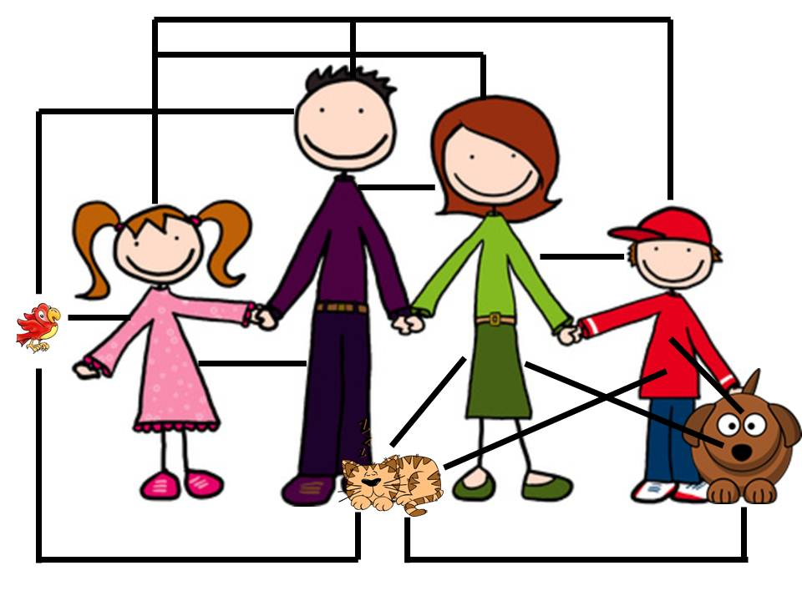
Coherence Coefficient [CC]
How close are the Small Family? [That is, do they hang out together a lot, or do they each do their own thing?]
High CC
Low CC
Notes:
Mentioned before that FBNs can be measured whereas modules cannot…there are various ways of doing this. For example…if we were to measure the Small Family network CC, a high CC would show that they are “close” whereas a low CC would suggest that they don’t like spending a lot of time together or have little or nothing in common

Slide 19
Characteristic Path Length [CPL]
How connected is each member (node) of the Small Family? [That is, even if they do hang out together, are they actually happy about it?]
High CPL
Low CPL
Hint!
Notes:
CPL can also provide a quantitative measure of the Small Family Network structure – a low CPL suggests that they spend a lot of time interacting (so presumably like each other), whereas a high CPL suggests that they try to avoid each other as much as possible.

Slide 20
Mutual Information [MI]
Are the Small Family members open and honest or sneaky and secretive?
[That is, do they ever really talk?]
High MI
Low MI
So how was your day?
K
Really? That bad?!?
OMG Mum you should’ve seen the Qs on my maths test!
Bark
Notes:
We can also measure communication between each member of the Small Family by using MI…high MI = lots of talking, low MI = nothing in common

Slide 21
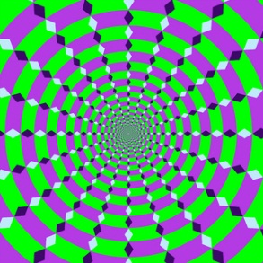
Entropy [En] aka chaos
Does the Small Family go to pieces under pressure? [e.g. parent-teacher interviews or school concerts] How long can they stand the pressure before they crack up?
A measure of (i) unavailability of a system’s thermal energy for conversion into mechanical work; (ii) the disorganisation or degradation of the universe; (iii) rate of transfer of information in a message.
[Aust. Concise Oxford Dictionary 4th Ed.]
High En
Low En
Notes:
Then there’s the measure known as entropy…Entropy is a measure of rate of information generation. In other words, it is a concept addressing randomness and predictability, with greater entropy often associated with more randomness and less system order [146]. It is a non-negative quantity and measures the uncertainty of a random variable. Usually, a high value corresponds to the increased irregularity or unpredictability while a low value corresponds to high regularity. The brain activity, resulting from firings of billions of neurons, as recorded from the human scalp (EEG) appears to be chaotic and non- linear. Cognitive perturbation may introduce measurable changes to the randomness of the neuronal activity.

Slide 22
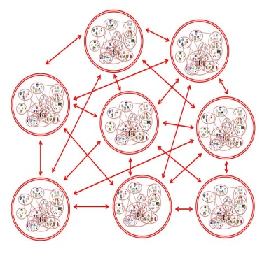
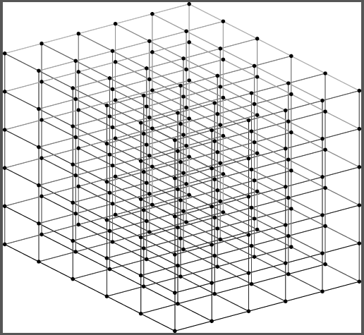
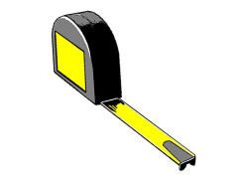
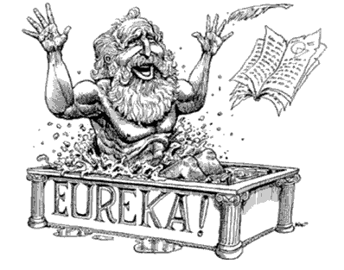
Graph Theory
Notes:
And if we put everything together, we pretty much get Graph Theory…

Slide 23
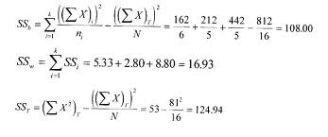
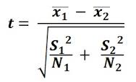
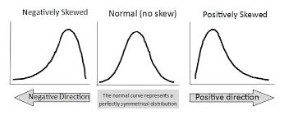
I lied…
∂
ß
π
∞
{1 + 1 + 1 + 1} ÷ 4= { √99.43 + 0.57}/9²+1
{Δ + Ᵽ} ÷ᴂ = 2.344454667788
≥
÷
{Δ + ∞} ÷ √∂= 0.0000000000012897
Δ
ʢ
ⱷ
√
≠
∞
Ω
∂
∩

Slide 24
Thanks for listening ☺…
…any (non-mathematical) questions?

