Slide 1
Design and Development 101
School of Education
June 26, 2012

Slide 2
What’s involved in designing a course?
Identify the difference between learners’ current knowledge, skills, abilities, attitudes, beliefs, worldviews (...and others) and an intended set of knowledge skills, abilities, attitudes...etc
then devise a process for eliminating that difference and
a way to determine if it that has been achieved.
Notes:
Doesn’t this apply to *all* courses, regardless of delivery mode??

Slide 3
ADDIE: A systematic approach
Analyse – analyse learner characteristics, task to be learned, etc.
Design – define learning objectives, assessment, choose an instructional approach
Develop – create materials, set up environments
Implement – deliver or distribute the instructional materials
Evaluate – make sure the materials achieved the desired goals

Slide 4
Analysis
Collect information
Contextual analysis: What parameters exist?
learner analysis identify learners, what they bring to the learning situation
needs analysis to identify the performance gap(s)
instructional analysis to determine the knowledge, skills etc involved in bridging the performance gap
Conceptualise the design task

Slide 5
Learner analysis
Who are the learners? What do they already know? What can they do? What sort of experience do they have? What problems do they have? What do they need? What do they want? What might keep them from succeeding? Language? Educational background? Cultural background?
Where do we find this information?
Notes:
Key points:
Learners are not a homogenous group---though we sometimes talk about them that way...
Identify sub-groups, major constituencies
Balance catering to diversity, catering to ‘the group’

Slide 6
Needs analysis (1)
What do learners (know, believe, do) now?
What do they need to (know, believe, do) after the course?
The difference between 1&2 defines their needs in terms of learning and helps identify the ‘goals’ for the design project.
Notes:
How do we find this information?

Slide 7
Instructional analysis
What is involved in the learning to meet the performance gap?
Elaborate the things that need to be learned
How are those things ‘learned’?
Devise a strategy to facilitate and support the sort of learning identified above.

Slide 8
What needs to be learned?
‘Officially’
...and also
Demonstrate developing information literacy in locating, evaluating and using relevant information from the internet
Compare and contrast learning theories
Identify appropriate information and communication technologies for effective learning
Apply knowledge of learning theory and instructional design in developing material for E-Learning
Practical skills
Engagement with TEL trends
Collaboration skills
Learn to learn (online)
Computer mediated communication
Problem solving
(others)?

Slide 9
Elaboration (Outcomes)
Demonstrate developing information literacy in locating, evaluating and using relevant information from the internet
Apply knowledge of learning theory and instructional design in developing material for E-Learning

Slide 10
What’s my instructional strategy?
How is (my subject) learned?
What do I need to do to support and facilitate that learning?

Slide 11
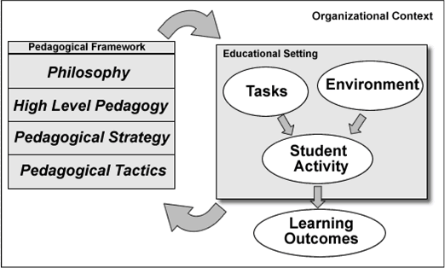

Slide 12
Needs Analysis (2)
What do learners need to be successful in the intended learning process?

Slide 13
Analysis challenges
Getting good information about learners
Risk: ignore available information/Relying on history/experience (instead of data)
Treating the learner cohort as homogenous
Constrained thinking as a result of administrative requirements

Slide 14
Before you design...
Know your
learners
context
learning environment/s
content
goals (objectives, intended outcomes)
high level instructional strategy

Slide 15
Design process
Establish broad course design as process
Developmental approach
Consider sequence
Relative ‘size’ of constituent parts
Elaborate the process, work from big→small (iterative)
Outcomes
Content
Intended Activity
Tuning
Workloads?
Timing and Pacing?
Supportive structure?
Structure vs. Flexibility?

Slide 16
Course as Process

Slide 17
Course Process
What are the (large) structural elements? (e.g. weeks, modules, topics)
What are the other key pieces (e.g. assessments, breaks)
What is the sequence of large elements? (is this fixed or flexible?)
How do the elements relate to one another?
How do the elements support course-level outcomes?
How do the elaborated outcomes map onto the proposed structure?

Slide 18
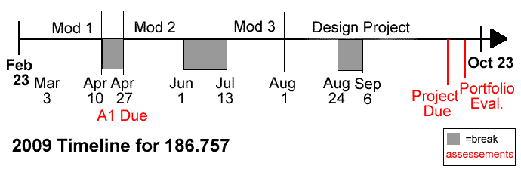
Process Diagram

Slide 19
Then elaborate (and again)
Work from big to small
Course→ Module→ Task
Work from end to beginning
Work from where learners need to be to where they are
Explicate relationships
course objectives→ module outcomes → task outcomes
Task → Intended Activity → Learning

Slide 20
Elaborate the process
Course outcomes:
Demonstrate developing information literacy in locating, evaluating and using relevant information from the internet
Compare and contrast learning theories
Apply knowledge of learning theory and instructional design in developing material for E-Learning
Identify appropriate information and communication technologies for effective learning
Module outcomes, Mod 1:
Use the internet to find authoritative supporting material on instructional design and learning design
Identify broad categories of learning theory and link learning theory to design practice
Demonstrate understanding of the background of instructional design, including basic ID models
Apply broad ID frameworks to instructional design tasks in context
Describe the relationships between historical views on ID and more contemporary notions of learning design

Slide 21
...from outcomes to tasks
Module 1 outcomes | Possible tasks
Use the internet to find authoritative supporting material on instructional design and learning design | Information searching, within given parameters or open
Demonstrate understanding of the background of instructional design, including basic ID models | Explanation of ID models, Identification of ID phases, Linking ID model to practice
Apply broad ID frameworks to instructional design tasks in context | Authentic ID work (mapping, writing learning objectives, task writing)
Describe the relationships between historical views on ID and more contemporary notions of learning design | reflection, situated comparison
Identify broad categories of learning theory and link learning theory to design practice | Create & work with an organiser; analysis of examples;

Slide 22
Elaborate the process
 | Module 1
 | Week2 | Week3-4 | Week 5 | Week 6 | Week 7
Learning tasks | 1.1: Information search 1.2: reading 1.3 discussion 1.4 formal reflection prep | 1.5 web search 1.6 reflection 1.7 reflection | 1.8 Reading 1.9 Reading 1.10 reading | 1.11 Group wiki task | 1.12 Reading 1.13 Reading
Assessment tasks |  |  | Formal Reflection |  | Begin Ass 1 from Group wiki task

Slide 23
Elaborate the process
Module 1
Week 2 | Week 3-4 | Week 5 | Week6 | Week 7
1.1: Information search
1.2: reading
1.3 discussion
1.4 formal reflection prep and submission
 | 1.5 web search
 | 1.6 reflection
 | 1.7 reflection
 | 1.8 Reading
 |  | 1.9 Reading
 |  | 1.10 reading
 |  |  | 1.11 Group wiki task and assignment 1
 |  |  |  | 1.12 Reading 1.13 Reading

Slide 24
Representing your course design
Activity: Process diagram/timeline
Timescale
High level structure
Content: Conceptual outline
Key ideas
Relationship between ideas
Sequencing
Course Map:
Brings Activity and content together
Allows us to see multiple aspects of the course design

Slide 25
Process Diagram

Slide 27
Course Map

Slide 28
What makes a design ‘good’?
Outcomes are achieved
Users’ (other) needs are met
Users are motivated/want more
Efficiencies are realised, better cost: return
Design supports reuse, extension
Design produces valuable by-products
Sustainable (learning and teaching)
Others??

Slide 29
Design
Know the intended outcome(s)
Elaborate them to an operational level
Be explicit
Course as a process (beginning, middle, end)
Developmental approach, progressive development
Determines sequencing, structure
Develop the instructional strategy
Pedagogy, from theory to practice
Foreground learners and what they do
Then consider teaching roles, activity
Operational level: Focus on task, activity (task design)
What are we asking learners to do?

Slide 30
Products of the design process
Completed course map as blueprint for development
Structural blueprint/process diagram
Course outcomes map
Modular outcomes map
Assessment scheme
Learning tasks list, map
Topical outline
Content list (readings, resources, etc)

Slide 31
Questions?

Slide 32
Development: bringing the design to life
Learning materials
Content (printed, audio, video, other)
Support materials (instructions, exemplars, tasks)
Learning environment
Online
Lecture/tutorial
Teaching notes
Consider teaching roles relative to pedagogy, intended learning activity

Slide 33
What are ‘learning materials’? Isn’t this just ‘content’?
Lectures
Study notes
Texts
Task descriptions
Exemplars
Organisers and heuristics
Other?

Slide 34
Questions?

Slide 35
Course example
http://resource.unisa.edu.au/course/view.php?id=4213

Slide 36
Design
The overall system: Conceptualise the course as process
Pedagogy, from theory to practice
Context
Learners and what they do
Break down and elaborate the process
Modules (activity based or content based)
Elaborate outcomes
Focus on task, activity (task design)
Design to support and facilitate learning activity
Developmental approach
Learner support (static, dynamic)
Motivation

Slide 37
Experiences of ‘Course Writing’
‘Traditional’ f2f teaching
Work within predefined structures
Create meaningful place-based experiences
Transmit information
Organise instructional events
Work in ‘real time’
Work in the same (physical) place
Distance Education
Value on flexibility, limited structure
Support individual activity, learning
Transmit information-
Organise instructional events
Materials as teacher
Work at a distance (physical, social, psychological)
Online education
Value on productive experience, structure follows outcomes focus
Transmit information-
Organise activity
Combined ‘static’ and ‘dynamic’ teaching
Technology mediates activity, experience
Focus on activity:
Prepare presentations
Select materials
Select, sequence and present ‘content’
Learners often isolated from one another/collaboration is difficult
Select, sequence and present ‘content’
Rich media
Work (mostly) independent of in-person instruction
Teachers work ‘in person’, lots of dynamic teaching
Assess Performance
Assess Performance (written)
Assess Performance
Work asynchronously
Work synchronously or asynchronously
What are we asking learners to do?
How are we supporting that activity?

Slide 38
Place based
Online
Places provide structure in learning environments
Time structures are given
Experience creates efficiencies
Structure
Pacing
Communication
Pedagogy
Contextual factors promote
‘delivery’ approach
‘traditional’ teaching roles
CONTENT- activity
Online spaces (and tools) provide structure
Time can be reconsidered
Inexperience creates questions, uncertainty
Choice can be overwhelming
Tension between familiar and ‘new’ teaching
Tension between learning and teaching
DE legacy and inexperience promotes “independent learning”
Content-ACTIVITY

